Slide 1
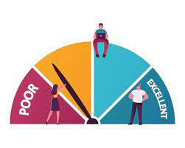
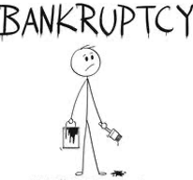
Ratio Analysis
Solvency Ratios

Slide 2
Learning Outcomes
Appraise the solvency position of the business entities.
Recommend how businesses could improve their long – term solvency position.

Slide 3
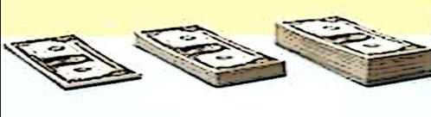
Solvency Ratios
Calculated to determine the ability of the business to service its debt in the long run.
Fund Providers
Safety of ‘interest’ payments
‘Repayment’ of their capital

Slide 4
Liquidity Vs. Solvency
Liquidity
Whether CA can pay off CL?
Short – term basis (a year)
Solvency
Whether enough Assets, to pay off Long term loans?
Long – term basis (more than a year)

Slide 5
1.) Debt – equity ratio
Outsider Funds =
Preference share capital + long term loans + debts + bonds + loans from financial institutions
Long – term debts (Outsider Funds)
Shareholder funds (Insider Funds)
Insider Funds =
equity share capital + reserves and surplus – accumulated losses
Ideally D/E < 1

Slide 6
Poll
The company is having the following items on the liability side of the balance sheet in the FY 2022 (in Rs. ‘000).
Equity share capital = 1000, preference share capital = 800, long term loans = 400, debts = 200 and reserves = 100.
The ‘total debt’ of the company is _________
Rs. 1400
Rs. 1200
Rs. 1300
Rs. 1500

Slide 7
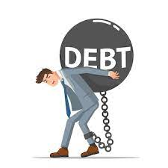
Debt > Equity (High debt equity Ratio)
1.) Interest burden increases
2.) Debt servicing is burdensome
3.) Leverage increases
4.) Benefit of ‘Trading on equity’
5.) Increase in Risk
6.) Less margin of safety to creditors
Notes:
Trading on equity means the use of fixed cost sources of finance such as preference shares, debentures and long-term loans in the capital structure, to increase the return on equity shares.

Slide 8
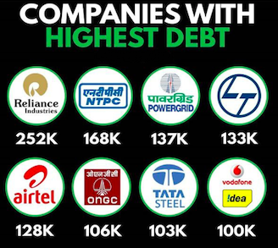

Slide 9
Poll
“The debt of Power Finance Corporation has risen to 179% in past 5 years.”
Which of the following statements is true with regard to the solvency position of the company?
The creditors of the company have enough margin of safety available for their money.
The leverage of the company is decreasing.
The interest burden of the company is increasing.
The company’s overall solvency position is satisfactory.

Slide 10
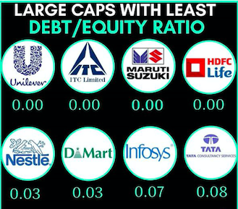
Case Analysis
Analyze the implications of low/’zero debt’ companies listed below

Slide 11
2.) Proprietary ratio or equity ratio
Shareholder Funds *₁₀₀
Total assets
Strong financial position
Great security for creditors
High Proprietary Ratio
Heavy dependence on outsiders for financing
Risk of bankruptcy
Low Proprietary Ratio

Slide 12
Poll
A company is having equity share capital = $500, reserves and surplus = $700, preference share capital = $500.
The assets of the company comprised of tangible fixed assets = $2000, intangible assets = $200 and current assets = $400.
In such case the ‘proprietary ratio’ of the company is:
47%
54%
42%
46%

Slide 13
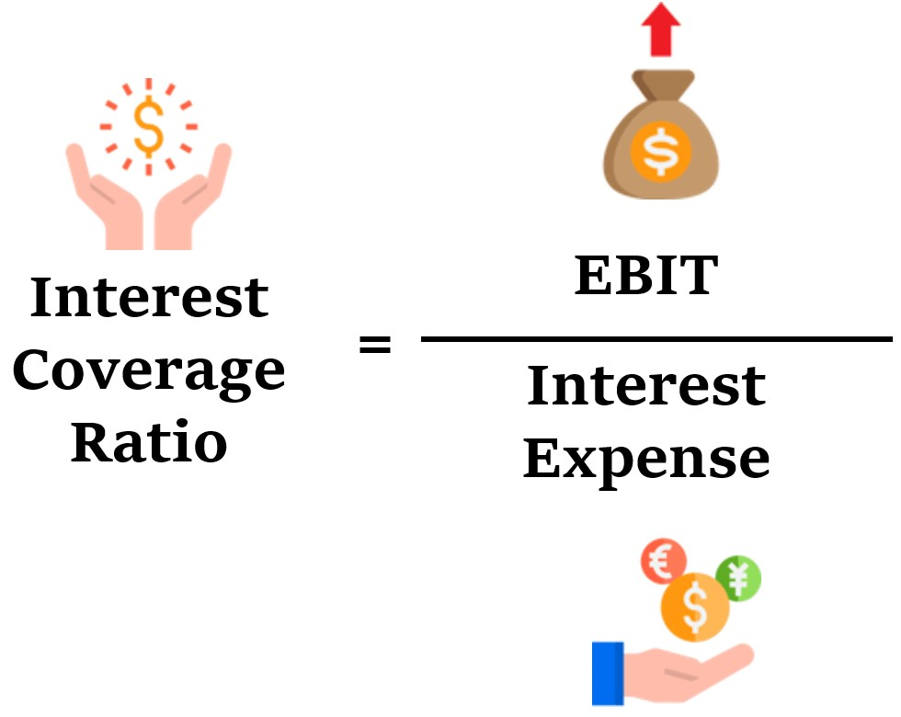
3.) Interest Coverage ratio
High ICR
Number of times interest is covered by profits
More safety available to creditors
Notes:
The interest coverage ratio is a debt and profitability ratio used to determine how easily a company can pay interest on its outstanding debt.

Slide 14

ICR of Marico
The EBIT of Marico is 1468 Crores rupees.
The total interest to be paid by the company is 50 crores rupees.
ICR = 1468
50
29.36 times

Slide 15
Poll
The earnings before interest and tax is $1000. The company has paid interest on loan $400 and taxes of $700.
The interest coverage ratio of the company is ________
3.4 times
4.2 times
2.5 times
4.4 times

Slide 16
Self Practice Question
Calculate and interpret the ‘interest coverage ratio’ from the following information of the company.
Net profit after tax = 500,000
10% long – term loan = 200,000
10% debentures = 100,000
Tax amount = 40000
Notes:
19 times

Slide 17


Analyzing the ICR of Oil Companies

Slide 18
Self Practice Question
From the following information, calculate the:
Debt–equity ratio
Proprietary ratio
Equity share capital = 400,000
Reserves and surplus = 100,000
Long term borrowings = 150,000
Current liabilities = 50,000
Fixed assets = 400,000
Investments = 100,000
Current assets = 200,000
Notes:
0.3:1 and 71.4%

